Slide 1

CAPSTONE PROJECT
CSA0697 -Design and Analysis of Algorithms for Lower Bound Theory
Critical And Pesudo-Critical Edges In Minimum Spanning Tree
Guided by,
Dr. Gnana Soundari
Presented by,
S.Thanveer
(192211443)

Slide 2


Critical and Pseudo-Critical Edges in Minimum Spanning Trees
This presentation explores critical and pseudo-critical edges within the context of minimum spanning trees. These special edges play a crucial role in understanding the structure and properties of these fundamental graph structures.

Slide 3
Definition of Critical Edges
A critical edge in a minimum spanning tree (MST) is an edge whose removal would increase the weight of the MST. It represents a bottleneck in the graph, ensuring the MST's efficiency.
Key Property
Impact of Removal
Critical edges are essential to maintaining the minimum weight of the MST.
Removing a critical edge disrupts the MST's structure, necessitating the addition of a heavier edge to restore connectivity.

Slide 4


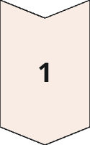
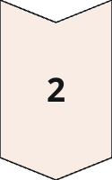
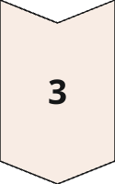
Identification of Critical Edges
Identifying critical edges involves examining the impact of removing each edge on the MST's weight. This can be done using algorithms like Kruskal's or Prim's algorithm.
Edge Removal
Start by removing an edge from the MST.
MST Reconstruction
Rebuild the MST using the remaining edges, ensuring connectivity.
Weight Comparison
Compare the weight of the reconstructed MST to the original MST. If the weight increases, the removed edge was critical.

Slide 5


Definition of Pseudo-Critical Edges
A pseudo-critical edge, unlike a critical edge, does not affect the weight of the MST when removed. Its removal might change the MST's structure, but the overall weight remains the same.
Non-Essential
Structure Modification
Pseudo-critical edges are not crucial to minimizing the MST's weight.
While their removal does not affect weight, it can alter the MST's path structure and edge connections.

Slide 6


Identification of Pseudo-Critical Edges
Identifying pseudo-critical edges involves a similar process to finding critical edges. However, instead of comparing weight increases, we look for edges whose removal doesn't change the MST's total weight.
1
Edge Removal
2
MST Reconstruction
Remove an edge from the MST.
Rebuild the MST using the remaining edges, ensuring connectivity.
3
Weight Verification
Compare the weight of the reconstructed MST to the original MST. If the weights remain equal, the removed edge was pseudo-critical.

Slide 7

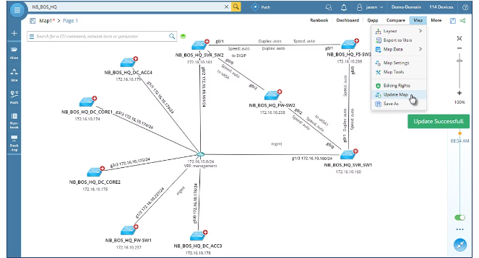


Applications of Critical and Pseudo-Critical Edges
Critical and pseudo-critical edges find applications in various fields, including network design, transportation planning, and resource allocation.
Network Optimization
Identify critical links to minimize communication
costs or enhance network resilience.
Transportation Planning
Optimize routes by analyzing critical roads or pathways for efficient traffic flow

Slide 8


Conclusion and Future Directions
Critical and pseudo-critical edges provide valuable insights into the structure and properties of minimum spanning trees. Continued research in this area could focus on developing more efficient algorithms for identifying these edges in large and complex graphs.

